Slide 1
RESUME OF
RESTAURANTS
KEYES ARCHITECTS & ASSOCAITES

Slide 2
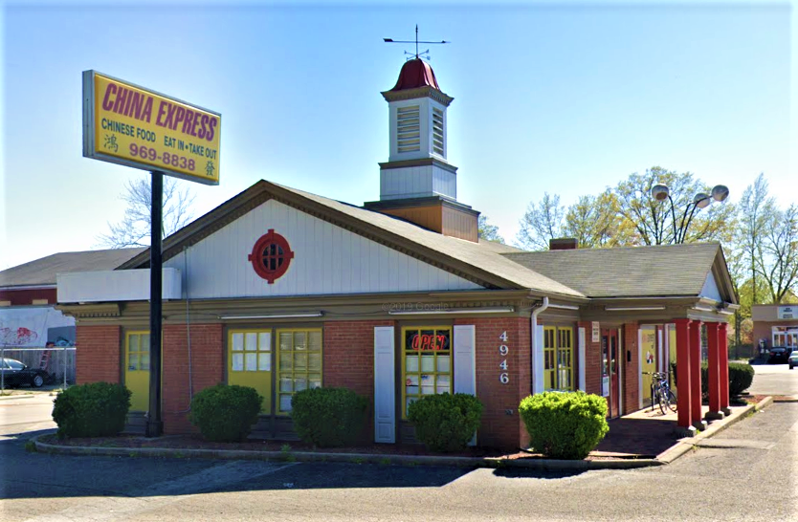
CHINA EXPRESS
LOUISVILLE, KENTUCKY
KEYES ARCHITECTS & ASSOCAITES

Slide 3
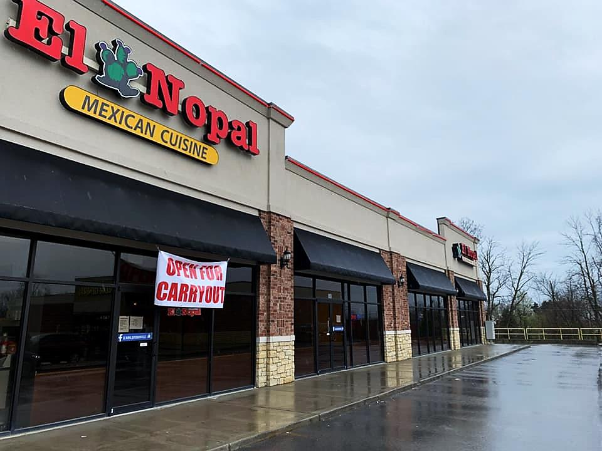
EL NOPAL
JEFFERSONVILLE, INDIANA
KEYES ARCHITECTS & ASSOCAITES

Slide 4
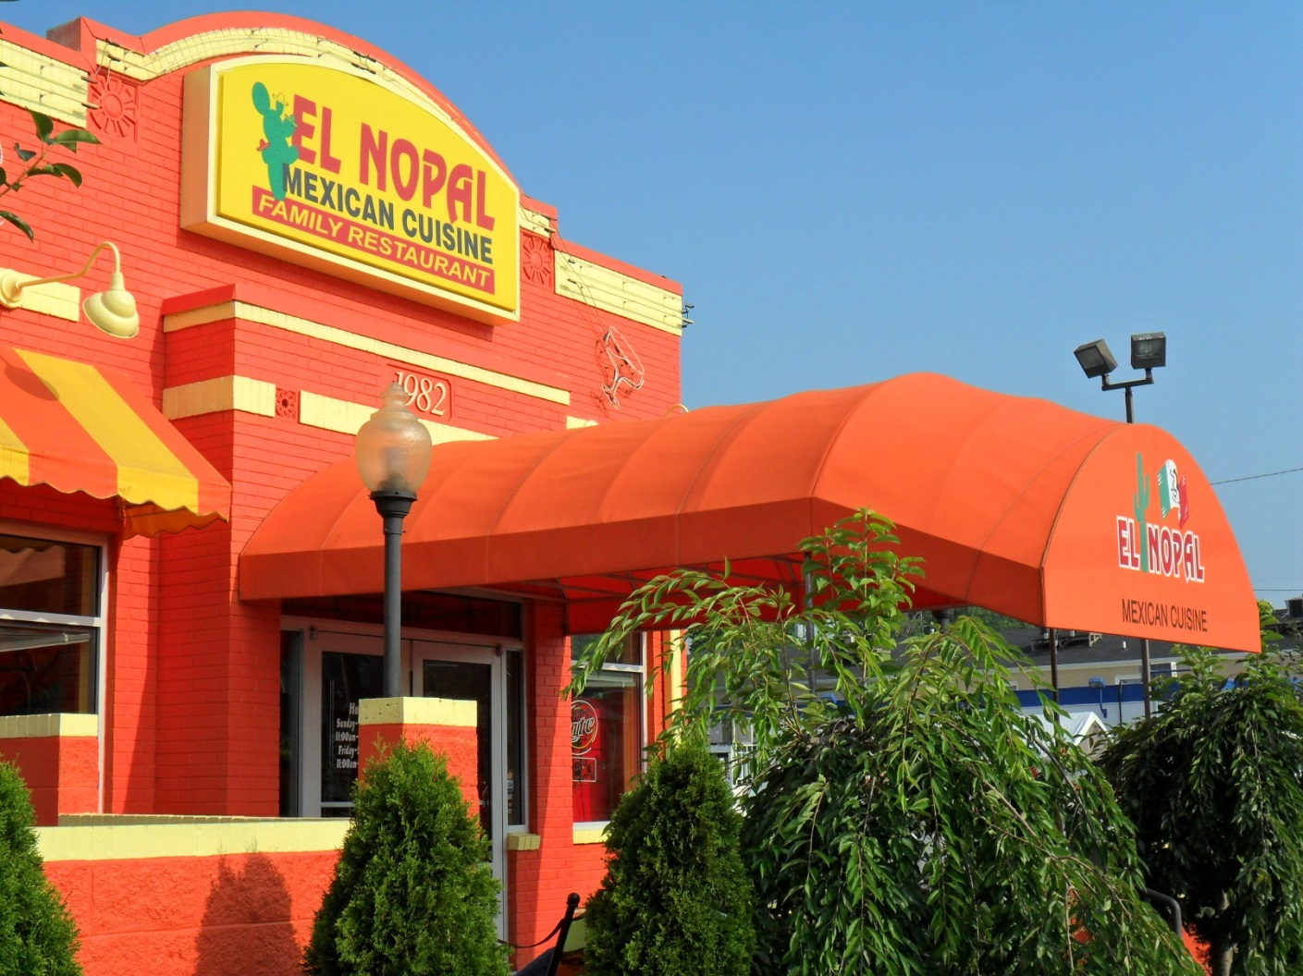
EL NOPAL
LOUISVILLE, KENTUCKY
KEYES ARCHITECTS & ASSOCAITES

Slide 5
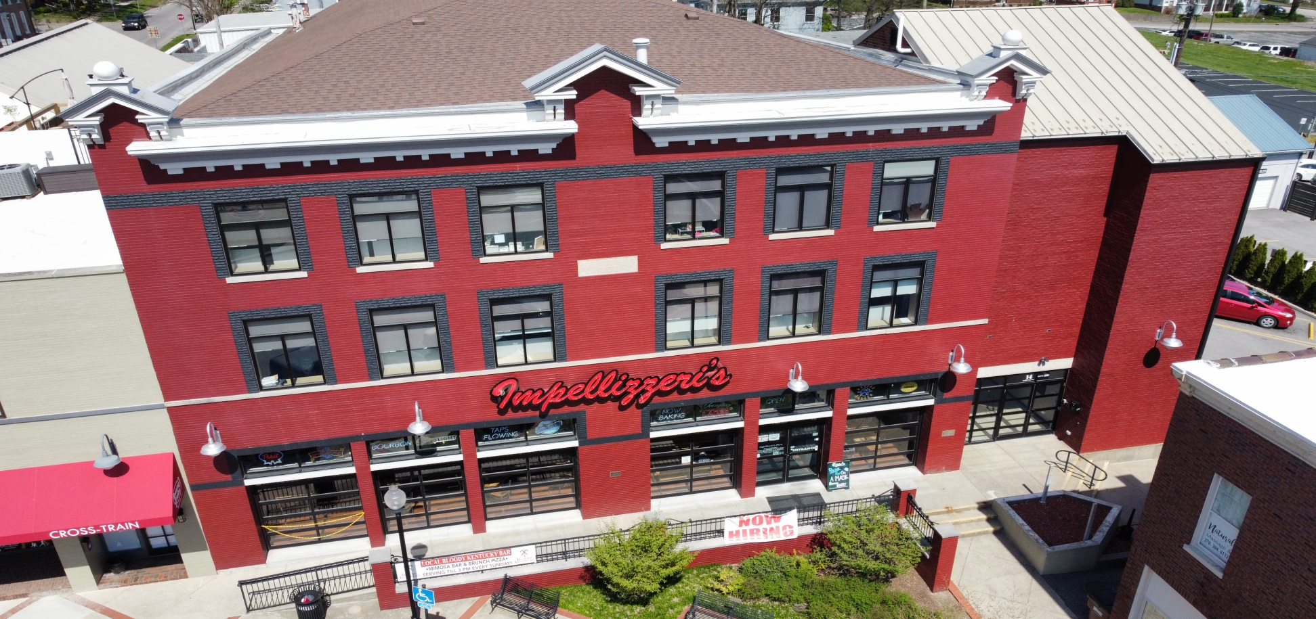
IMPELLIZZERI’S
ELIZABETHTOWN, KENTUCKY
KEYES ARCHITECTS & ASSOCAITES

Slide 6
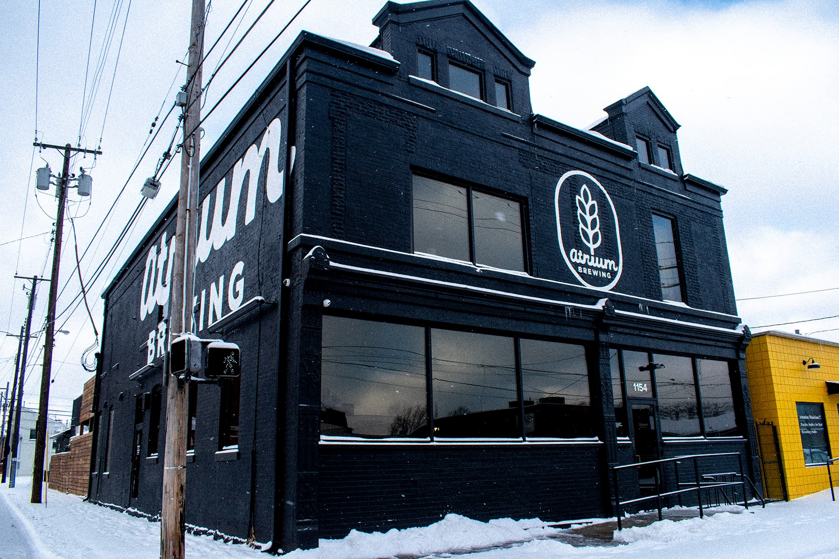
ATRIUM BREWERY
LOUISVILLE, KENTUCKY
KEYES ARCHITECTS & ASSOCAITES

Slide 7
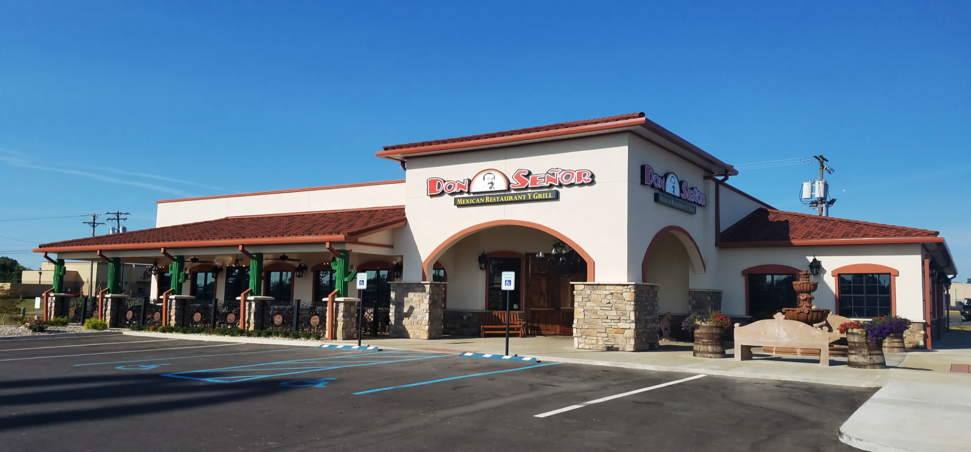
DON SEÑOR
MT. STERLING, KENTUCKY
KEYES ARCHITECTS & ASSOCAITES

Slide 8
DON SEÑOR
MT. STERLING, KENTUCKY
KEYES ARCHITECTS & ASSOCAITES

Slide 9
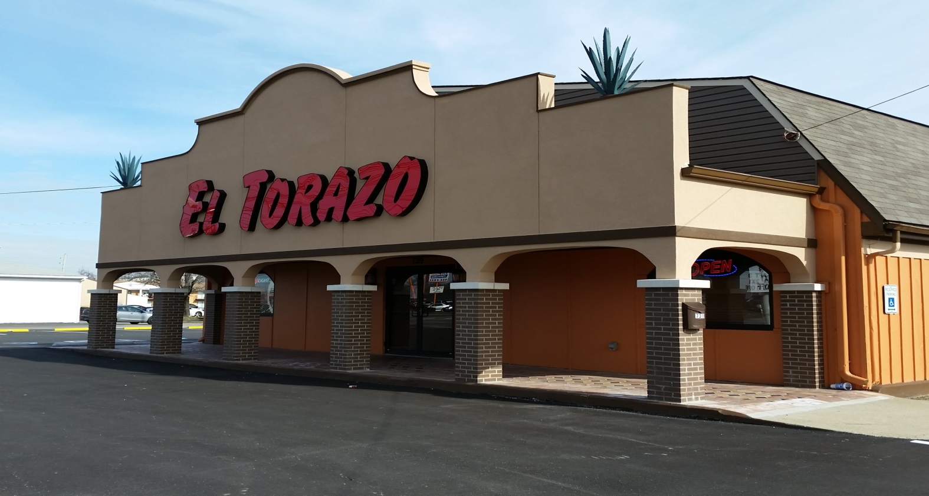
EL TORAZO
LOUISVILLE, KENTUCKY
KEYES ARCHITECTS & ASSOCAITES

Slide 10
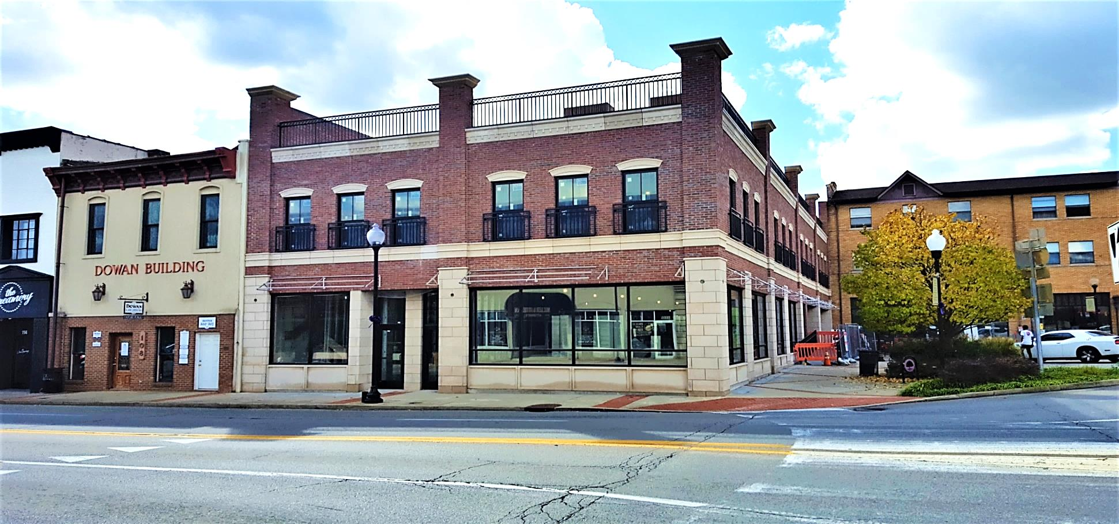
NEWBERRY BUILDING
ELIZABETHTOWN, KENTUCKY
Newberry Building
KEYES ARCHITECTS & ASSOCAITES

Slide 11
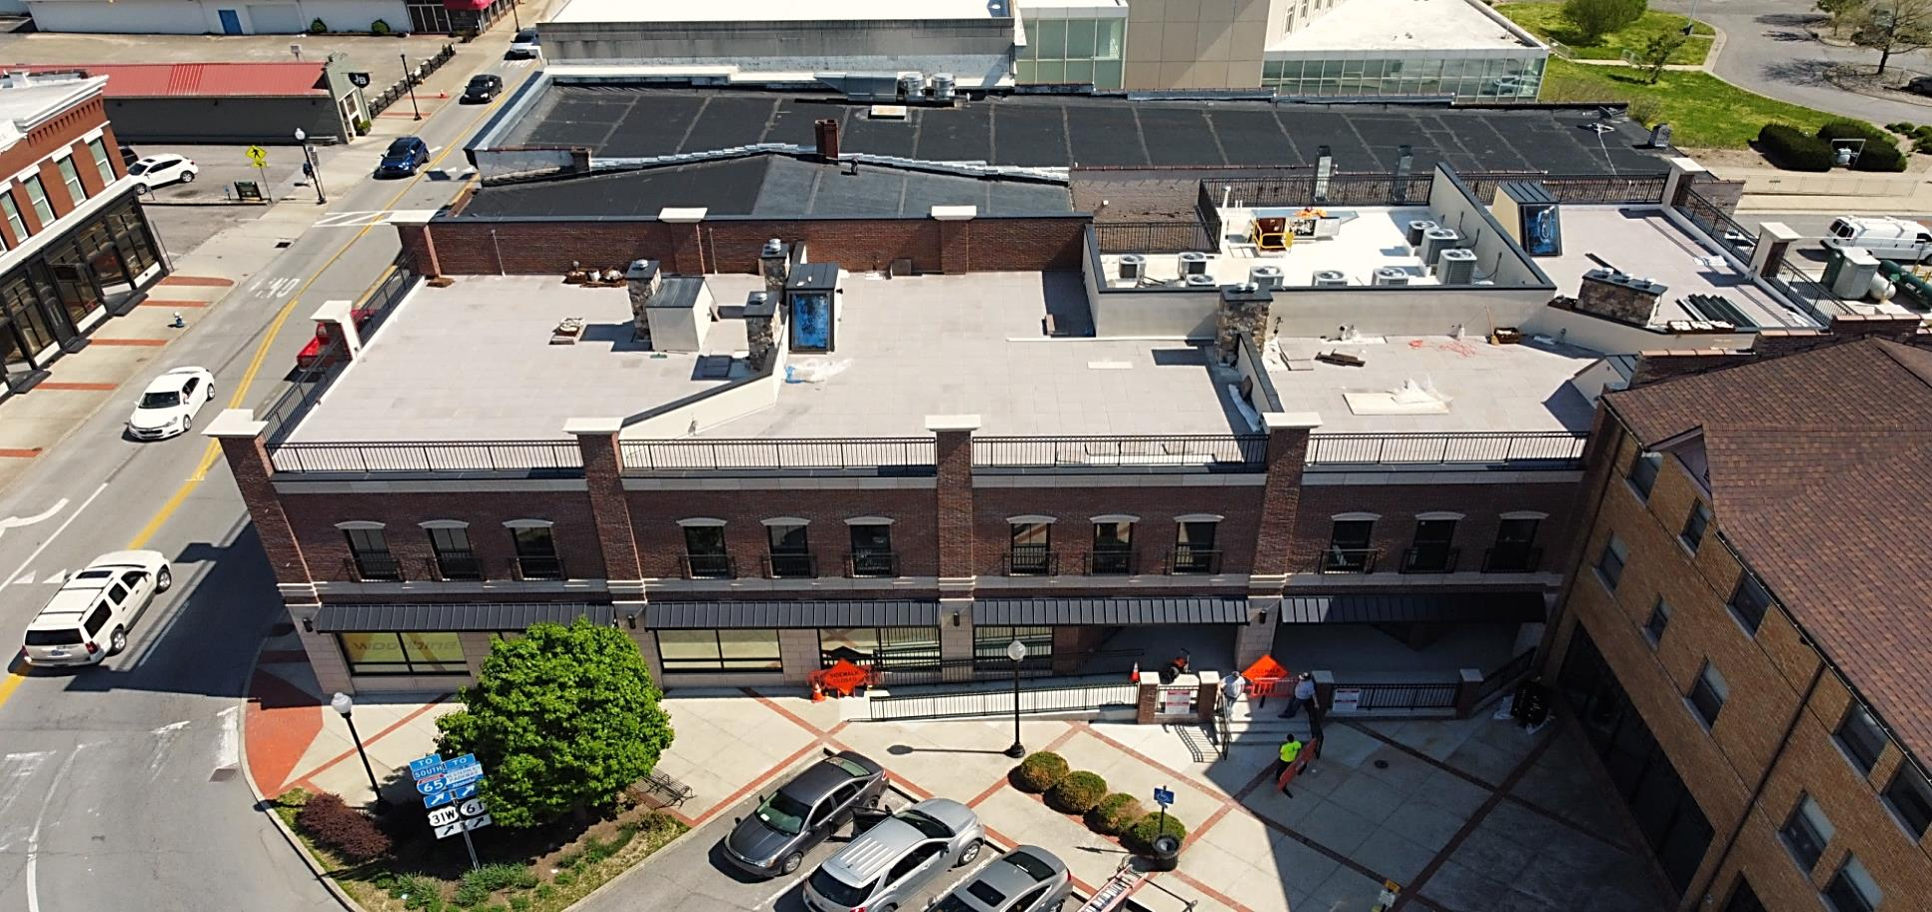
NEWBERRY BUILDING
ELIZABETHTOWN, KENTUCKY
KEYES ARCHITECTS & ASSOCAITES

Slide 12
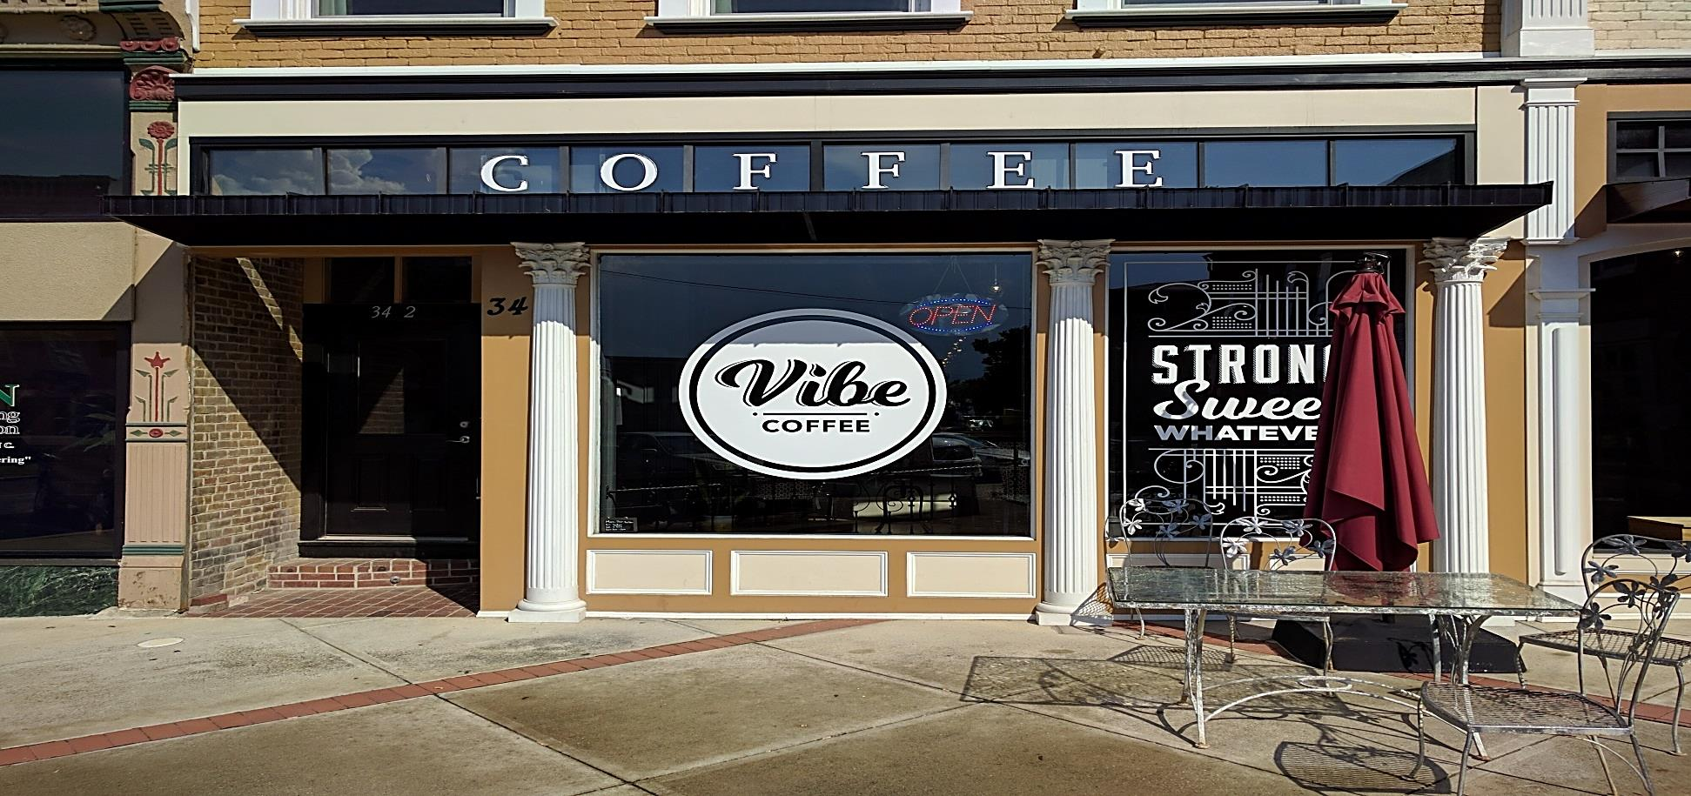
VIBE COFFEE
ELIZABETHTOWN, KENTUCKY
KEYES ARCHITECTS & ASSOCAITES

Slide 13
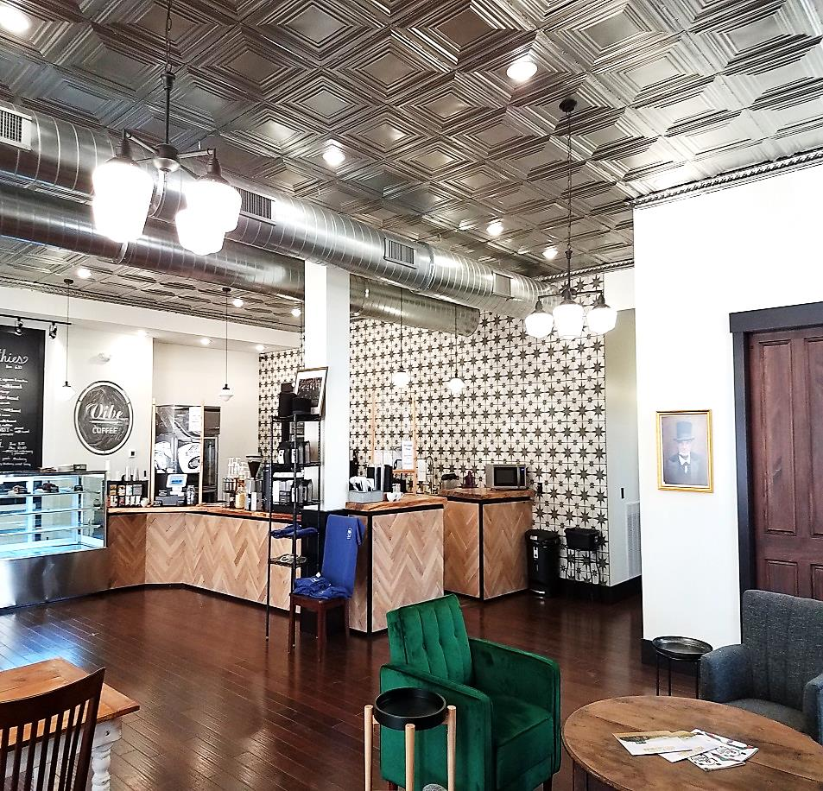
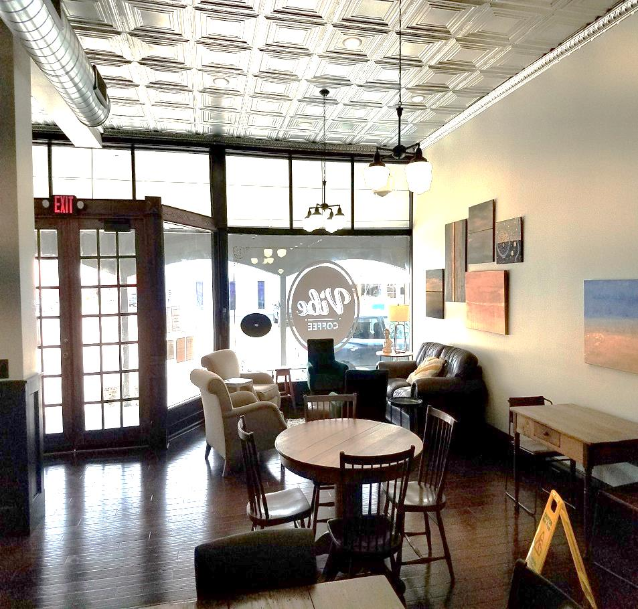
VIBE COFFEE
ELIZABETHTOWN, KENTUCKY
KEYES ARCHITECTS & ASSOCAITES

Slide 14
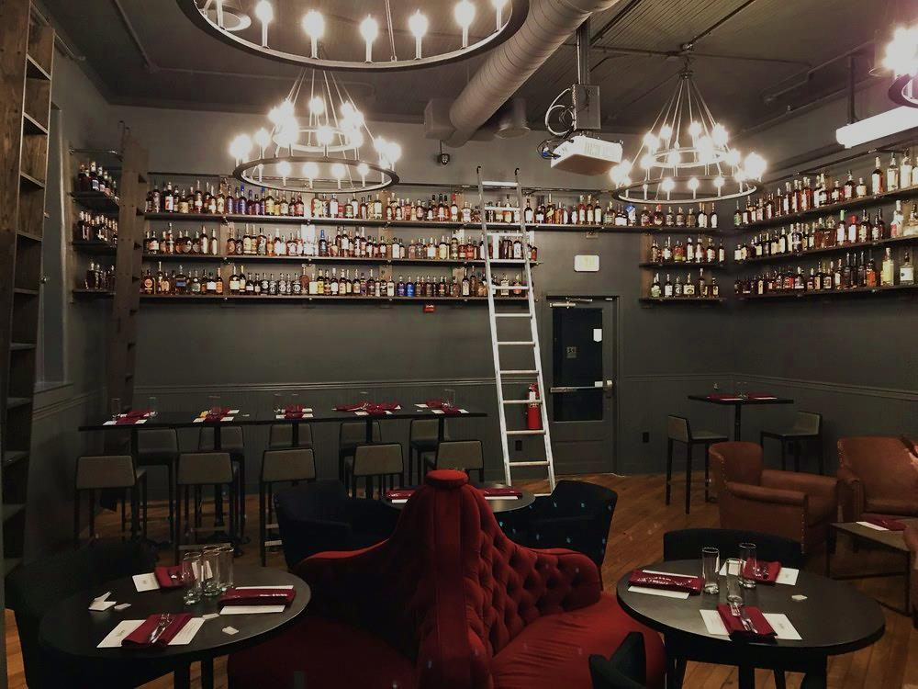
DOC’S BOURBON ROOM
LOUISVILLE, KENTUCKY
KEYES ARCHITECTS & ASSOCAITES

Slide 15
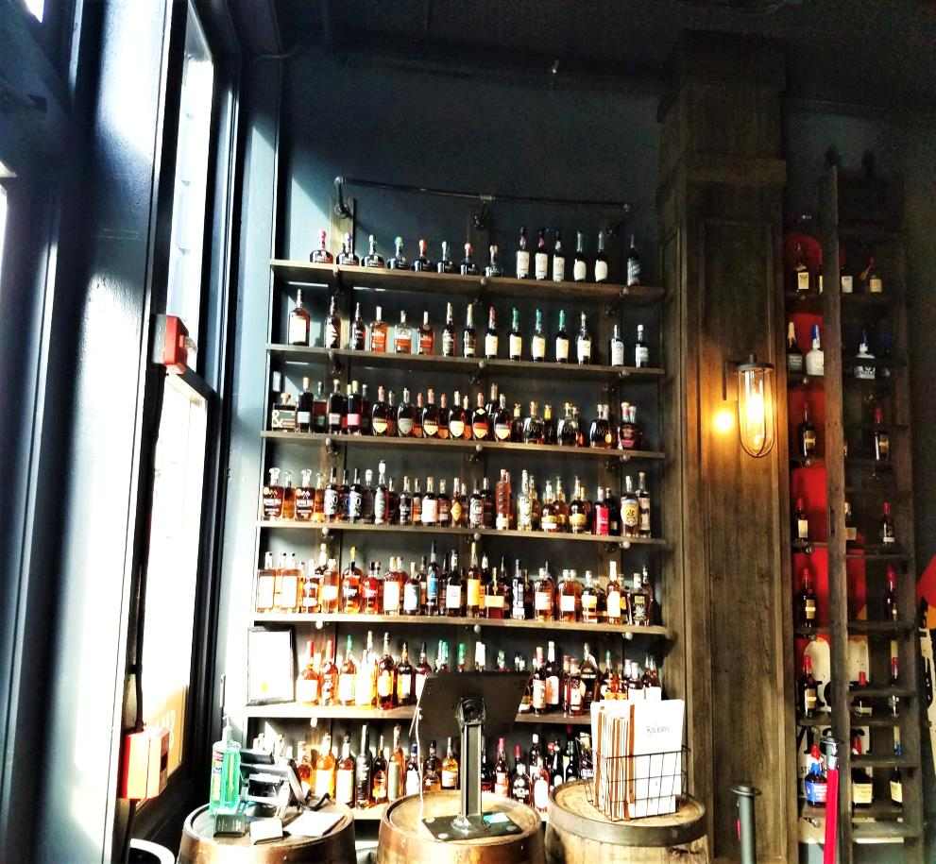
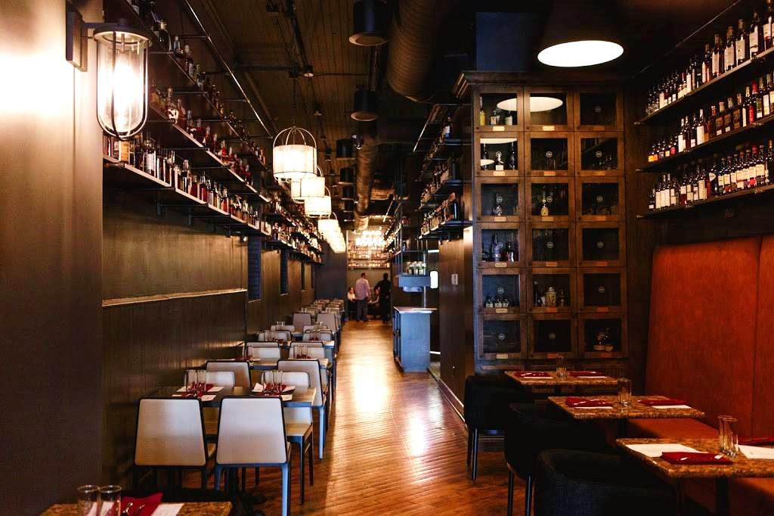
DOC’S BOURBON ROOM
LOUISVILLE, KENTUCKY
KEYES ARCHITECTS & ASSOCAITES

Slide 16
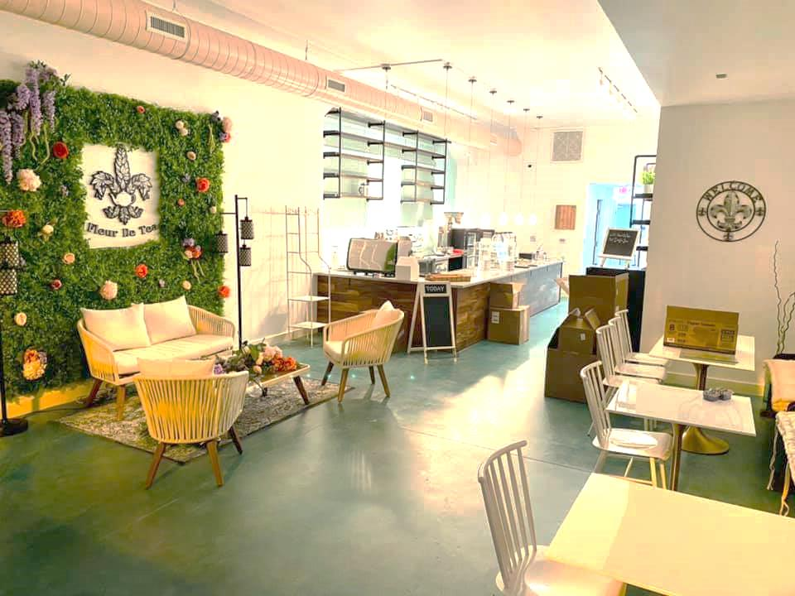
FLEUR DE TEA
LOUISVILLE, KENTUCKY
KEYES ARCHITECTS & ASSOCAITES

Slide 17
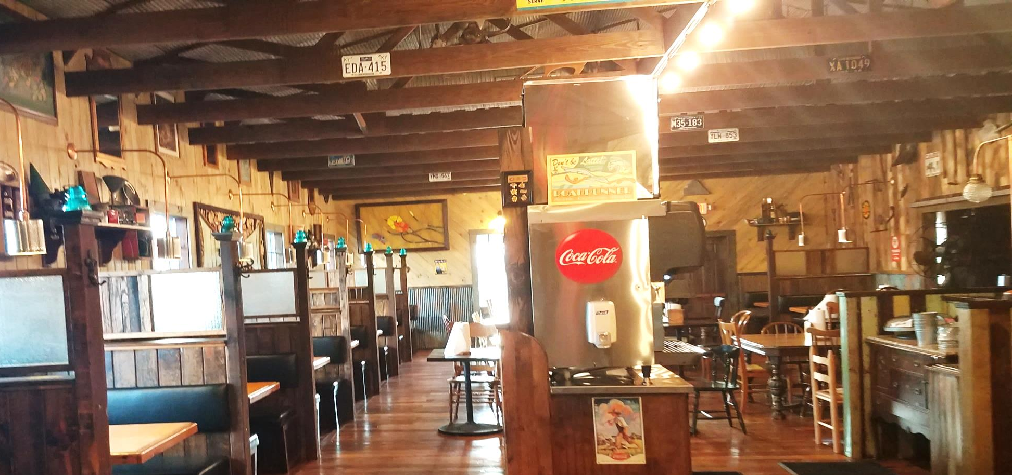
BOOTLEG BAR B Q
LOUISVILLE, KENTUCKY
KEYES ARCHITECTS & ASSOCAITES

Slide 18
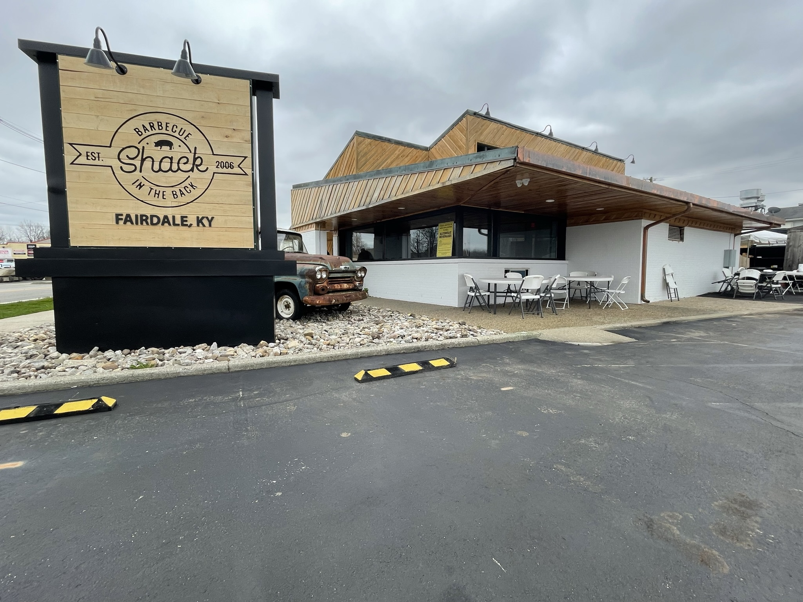
SHACK IN THE BACK
FAIRDALE, KENTUCKY
KEYES ARCHITECTS & ASSOCAITES

